Slide 1


One day Android Master with Firebase
-Fauzi Sholichin-

Slide 2







Android Development Tools 2019

Slide 3





Today :

Slide 4
Firebase Setup

Slide 5
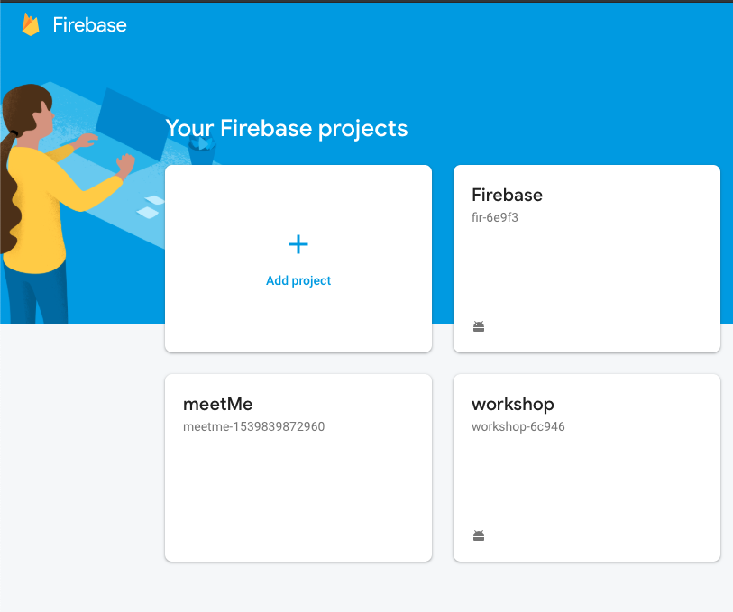
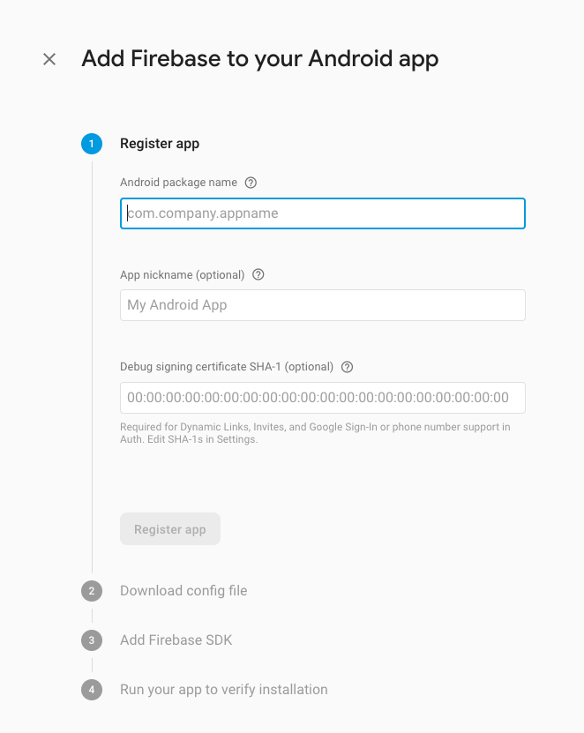
New Project

Slide 6
Add google-service.json

